Slide 1


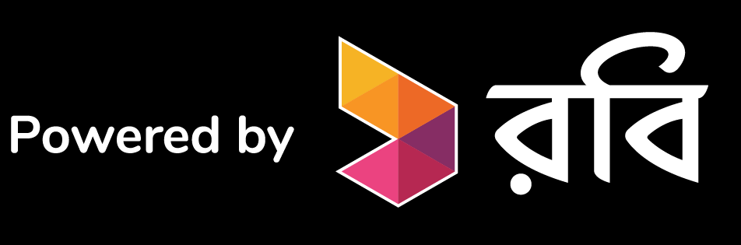
National Gala Round
Team EdgeFly
presenting
L.earn

Slide 2
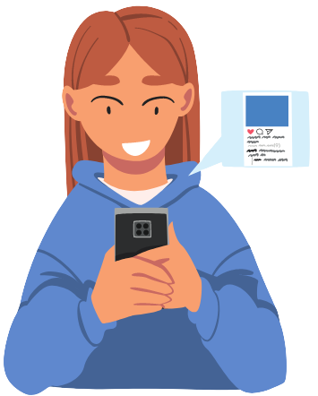

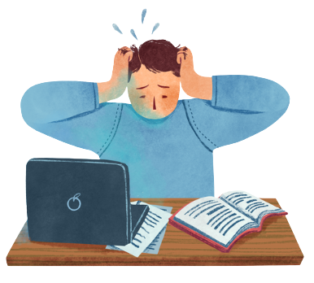
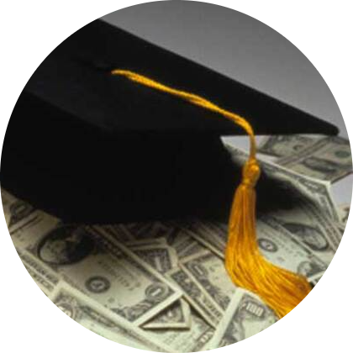
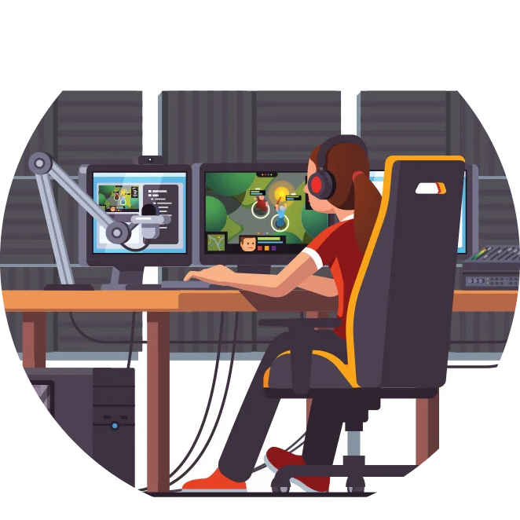


Target problems
LOSING
INTEREST
IN STUDY
NEGATIVE
USE OF
TECHNOLOGY
TROUBLE TO
FIND PART-TIME
JOBS
EARN MONEY
THAT IRRELEVANT
TO STUDY
Misuse TIme
EdgeFly

Slide 3
Our Solution
1. Introducing students with a platform of mobile app named L.earn .
2. Providing opportunities to earn a handsome amount of money by judging their skills via MCQ test.
3. Categorizing students by evaluating their knowledge & organizing several program after a certain period & prizing themselves.
4. Attracting students to our app by offering various educational gadget of their
dream.
5. Enhancing the chances of gathering students toward to us with lots of strategies. For example proposing educational tour, which is not only interesting but also instructive too.
6. We planned some best feature of developing skilled such as free class, admission suggestion, MCQ tips & trick, motivating students, providing career guideline, meeting their idol, entertainment program extra class etc.
EdgeFly

Slide 4
Our Uniqueness
1. After finishing the exam, immediately within 30 seconds, the top 10 students will be provided their reward.
There is no platform that has instant reward/reward system for their learners till now.
This is our main USP [Instant Reward].
2. We planned to provide free MCQ suggestions, MCQ pdf suggestion as well as MCQ live class to the student of class-9,10,11,12 (SSC,HSC) which is also unique for any Bangladeshi educational platform.
3. That is, a student can be MCQ boss by doing our free MCQ class at the same time he/she can get instant reward by attending our MCQ test.
EdgeFly

Slide 5
Market Size
1. Our targeted consumers are the students.
2. According to Bangladesh Education Board, in 2022, around
1 crore students studying in class-9,10,11 & 12.
So, the market size of our business is huge.
EdgeFly

Slide 6
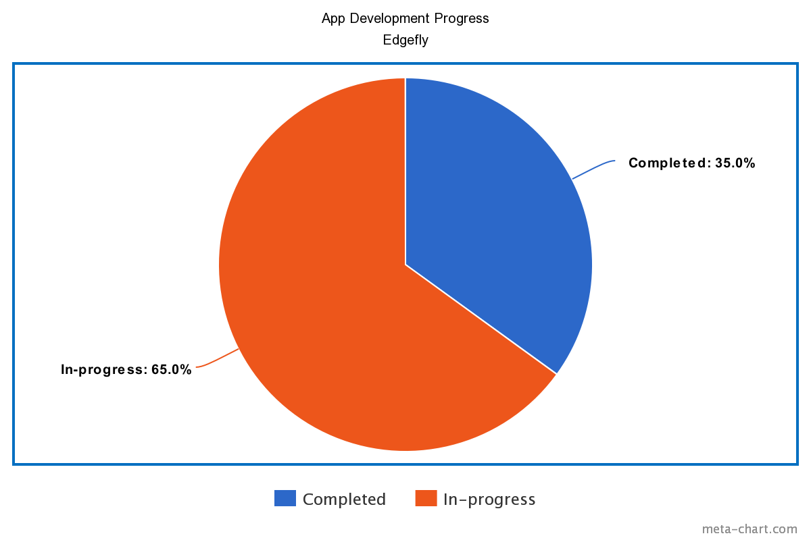
Your Progress
UI, UX, Backend
EdgeFly

Slide 7
Future Plan and Scope
1. Initially we have started with class 9-10(SSC) & 11-12(HSC) students.
2. We have planned for admission test & BCS preliminary students in future.
3. In addition, we have a plan of working with written exam feature along with MCQ exam.
EdgeFly

Slide 8
Targets and Plan of action (1st year)
1. Our target is only 10 thousands active users from 1 crore students for the first(1st ) year.
2. If we have 10 thousands active user daily then we can get 5,00,000 taka revenue per month where net profit margin is 65%.
EdgeFly

Slide 9
Marketing Plan
Campaign in School & College
Digital Marketing
Influencer Marketing
Ads on TV
EdgeFly

Slide 10
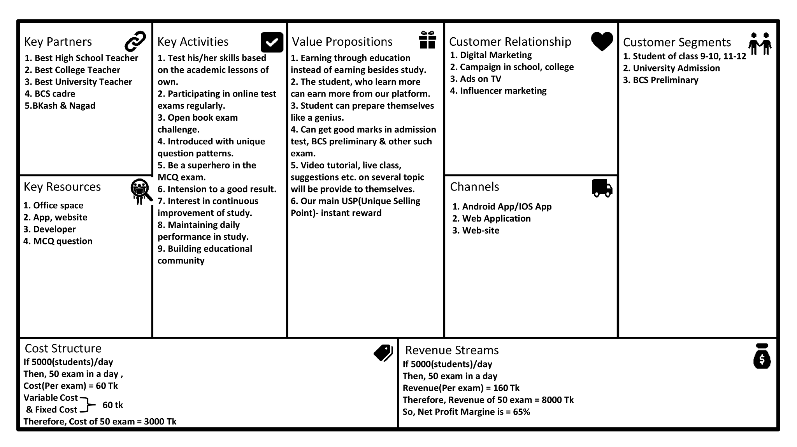
Business Model Canvas
EdgeFly

Slide 11
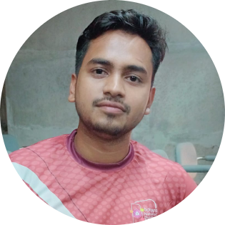
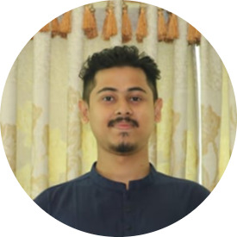
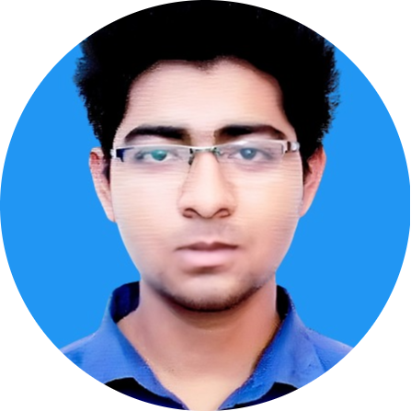
The Team
Abdullah Bin Gazi Joy
Md. Rakibur Rahman
Ifti Sikder
Business Researcher,
App Developer(Android)
2 Years of Experience
Mobile Application Developer
Android & IOS
3 Years of Experience
Digital Marketer,
App Developer(Android)
1 Year of Experience
EdgeFly

Slide 12
Open For Questions
EdgeFly

